Slide 1
FBISD Virtual Academies Open House
6:30-7:30—formal presentation
November 16, 2021

Slide 2
Presentation of Administrators, Counselors, and Student Support
Administrators | Counselors/Student Support
Sarah Laberge Principal | Britany Adelstein Lead Counselor
Mario MacDonald Associate Principal | Jeanne Andrews Counselor
Damien Bassett Assistant Principal | Seth Brodrick Counselor
Sandrea Cheek Assistant Principal | Cheryl Clark Counselor
Bard Hitchcock Assistant Principal | LaDale Lamb Counselor
Lisa Long Assistant Principal | Tenille Pakoejoe Counselor
Derryk Pope Assistant Principal | Brenell Young Counselor
Laine Skelton, Academy Coordinator
Jennifer Chadwick, Director of SEL & Enrichment Programs
Notes:
Introduce Julie, Julie Slide

Slide 3
Presentation of Teacher Facilitators and Academy Officers
Teacher Facilitators | Academy Officers
Kimberly Cain Global Studies Academy Teacher Facilitator | Mehaa Amirthalingam Global Studies Academy President
Vashon Lewis International Business & Marketing Academy Teacher Facilitator | Kelly Chang International Business & Marketing Academy President
Laine Skelton, Academy Coordinator
Jennifer Chadwick, Director of SEL & Enrichment Programs
Notes:
Introduce Julie, Julie Slide

Slide 4
Mission Statement
In partnership with home and community, it is our mission to create an environment of mutual respect and belonging in which we strive for excellence in both academic and extra-curricular programs.
Vision Statement
Travis High School will be a nurturing, safe and professional environment that supports academic success along with the social, emotional, and physical development of each student and staff member while consistently holding all to high expectations.
Notes:
Julie Slide

Slide 5
Why choose an academy?
Member of a cohort/small learning community
Shared interests for more in-depth learning
Enrichment opportunities
Service opportunities
Applicable coursework
Field trip opportunities
Dedicated coordinator
Dedicated booster club/parent support

Slide 6
Why choose OUR academy?
Exchange, travel, study abroad opportunities
Peer mentorships
Leadership opportunities through student governance and committees
Grade level field trips directly related to curriculum
Internship possibilities
Rigorous Application Process Required
Active CTSO’s allowing networking with business professionals and participation in competitions at the regional, state, and national level
Earn industry certifications
Notes:
Students do presentations

Slide 7
Why choose OUR academy? (cont.)
Philanthropy through community and school organizations
Self-designed study & research
Scholarships for study abroad
Choice of 6 world languages in which to go to the AP level
Specialized college visits and tours geared towards fields of study relevant to the business world
Leadership opportunities through student governance and committees
Philanthropy through community and school organizations
Notes:
Students do presentations

Slide 8
Sample Enrichment Activities
Guest Speakers: Diplomat in Residence, NGOs, Local Politicians
Annual Student-Led Global Issues Summit
Monthly Cultural Presentations
World Affairs Council International Careers Expo Night
FBISD CTED Presentations with industry representatives
FBISD CTE Annual Stemoscopes (or similar event)
Group Philantrohpy: Houston Foodbank, Houston Marathon, Buddy Walk, etc.

Slide 9
Sample Enrichment Activities (cont.)
Partnership Walk: Annual Walk Against Poverty
Various International Festivals (School & Community)
Qualifying Study/Travel Abroad during the school year; grant opportunities available
Rockets Marketing and Fundraising
HCC Teen Entrepreneur Summit (TrepStart)
Monthly meetings with Guest Speakers/Activities
Various CTSO qualifying competitions/events

Slide 10
Academy Program Requirements
Appropriate course sequence
Minimum grade requirements
Enrichment Activities (4/year)
Service Hours (100 total)
Levels I-IV AP of World Language
Designated ELA, SS, Business Courses
5 Credits in Social Studies
Senior Academy Capstone
6 Business Credits
4 Advanced Credits (Honors, Dual, AP)
AP Macro-Economics
Industry Certifications
Senior Graduation Project

Slide 11
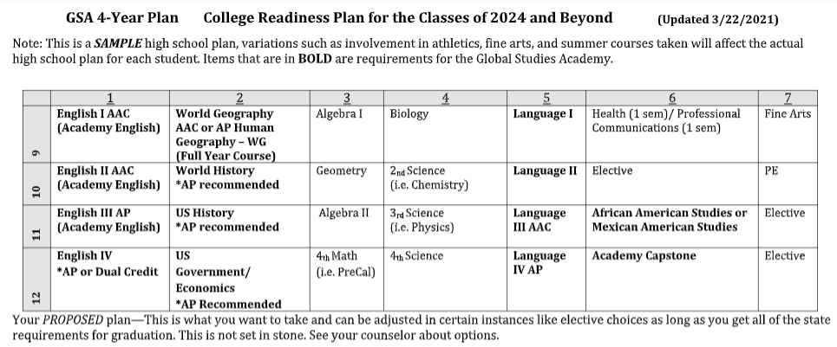
GSA Sample Four-Year Plan
**Requirements/Courses subject to change per state/district guidelines

Slide 12
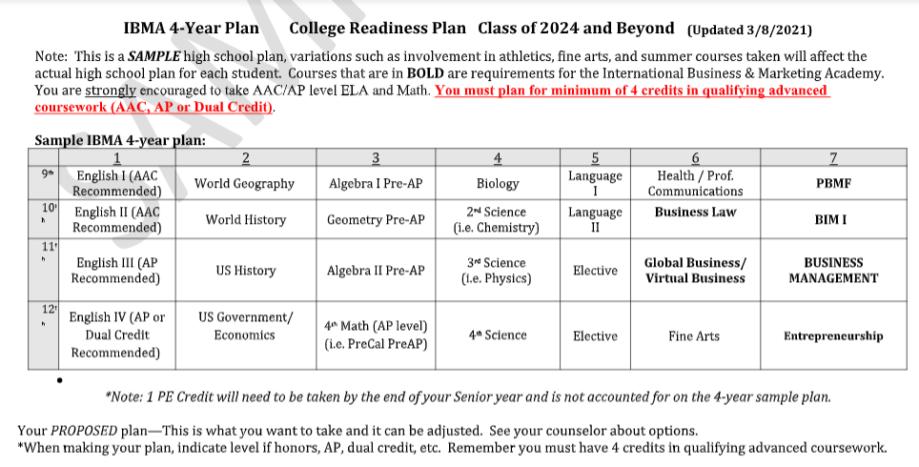
IBMA Sample Four-Year Plan
**Requirements/Courses subject to change per state/district guidelines.
**CTE courses are currently undergoing changes within TEA

Slide 13
Applicant Requirements
Success on all sections of the 7th grade STAAR (waive this year due to COVID-19).
Currently resides in FBISD Attendance zone
Currently in the 8th Grade
Academy Selection Criteria
7th grade semester grades in Math, Science, SS, ELA
8th grade semester grades in Math, Science, SS, ELA
Academy entrance exam grade

Slide 14
Application Process
Log on to https://academy.fortbendisd.com/
Current FBISD Students | Non-FBISD Students
Sign in using your Student User Name & ID (just like you would into a school computer) | Register – input your email and create a password. Use your email and password to log-into the application.
Answer All Questions | Answer All Questions
Address, parent information, and zoned campus are automatically pulled from Skyward | Input your address, parent information, and zoned campus information
Select the Academy(ies) for which you wish to apply | Select the Academy(ies) for which you wish to apply
Select the priority of each academy (1, 2, 3, …) | Select the priority of each academy (1, 2, 3, …)
No additional documentation is needed | Upload a PDF copy of the 7th grade report card. Also, input the actual 7th grade grades
Hit the Submit button to submit your application | Hit the Submit button to submit your application

Slide 15
Academy Interview
1 video interview for three academies:
Digital Media Academy
Global Studies Academy
International Business & Marketing Academy
Applicants given a preset of interview questions to record their answers and submit to the academy review committee
Interview Committee:
Panel of 3 FBISD staff members
Using a matrix to score the student’s answers
Questions will be sent via email

Slide 16
Step 1
Apply Online @ https://academy.fortbendisd.com/
Step 2
Get Validated
Step 3
Sit for academy exam/interview
Exam and interview date has not been determined
Application Steps
Step 4
Step 5
Attend Commitment Night
Priority 1 Notifications
Regular Window Notifications
Waitlist Notifications

Slide 17
Final Acceptance
Is contingent upon:
Successful completion of all 8th grade courses during the academic school year
Successful completion of all parts of the 8th Grade STAAR exam

Slide 18
Athletic Disclaimer
Any student attending an academy outside of the attendance zone in which he/she resides, will be ineligible for varsity athletic competition for one calendar year.

Slide 19
EIC Local
Class of 2024 & Beyond
Only the Top 10% will be ranked
Students attending programs of choice or students on an intra-district transfer will be ranked with their peers at the high school in which the reside, instead of the campus they attend.
Click Here for more detail about EIC LOCAL

Slide 20
Applications can be found online at: https://academy.fortbendisd.com/
(Opened November 1, 2021 & Closed November 30, 2021 )
More information can be found at:
http://www.fortbendisd.com/mathandscience

Slide 21
Contact Information
Laine Skelton
Academy Coordinator
Global Studies Academy
www.fortbendisd.com/globalstudies
International Business & Marketing Academy
www.fortbendisd.com/ibma
mary.skelton@fortbendisd.com
Office: (281) 634-2230
Fax: (281) 327-2230
SEL & Enrichment Programs: (281) 634-1129

